Slide 1
ZOMATO RESTAURENT REVIEWS AND SENTIMENT ANALYSIS
20C91A0507 B. Anjali
20C91A0539 P. Kavitha
20C91A0534 M. Malvika
UNDER THE GUIDANCE
Mrs .Ch. Vijaya Jyothi Mam

Slide 2
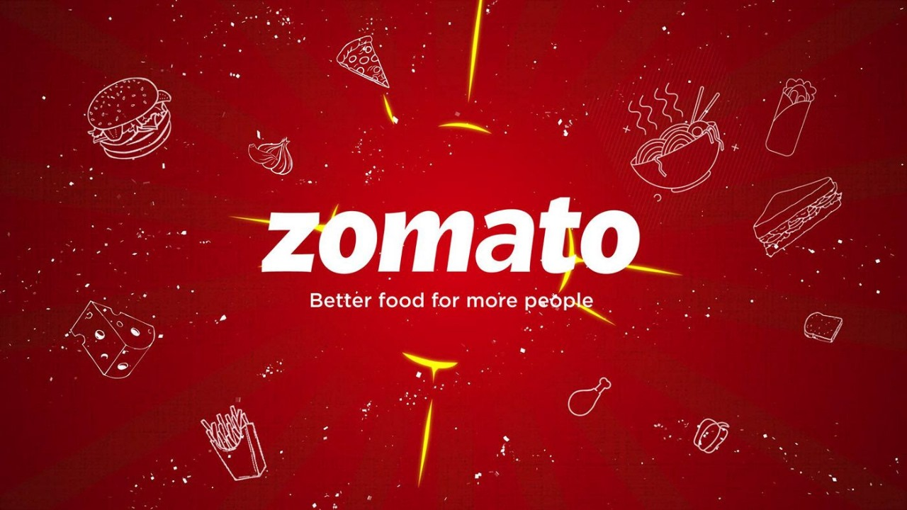
Contents
Abstract
Introduction
Existing System
Proposed System
System Architecture
Conclusion

Slide 3
ABSTRACT
Zomato is an online platform that provides restaurant discovery and food delivery services. sentiment analysis is one part of Natural Language Processing, that often used to analyze words based on the patterns of people in writing to find positive, negative, or neutral sentiments. Sentiment analysis is useful for knowing how users like something or not. Zomato is an application for rating restaurants. The rating has a review of the restaurant which can be used for sentiment analysis. The method used for preprocessing the review is to make all words lowercase, tokenization, remove numbers and punctuation, stop words, and lemmatization. Then after that, we create word to vector with the term frequency.inverse document frequency (TF-IDF). The data that we process are 150,000 reviews. After that make positive with reviews that have a rating of 3 and above, negative with reviews that have a rating of 3 and below, and neutral who have a rating of 3. The author uses Split Test, 80% Data Training and 20% Data Testing. The metrics used to determine random forest classifiers are precision, recall, and accuracy. The accuracy of this research is 92%. The 10 words that affect the results are: “bad”, “good”, “average”, “best”, “place”, “love”, “order”, “food”, “try”, and “nice” in today’s digital era where everybody has their own opinion and so can post various feedbacks .
Key words: Food Reviews, NLP, Opinion Analysis, Sentiment, Text Visualization

Slide 4
LITERATURE REVIEW:
The literature survey section will provide an overview of the existing research on the sentimental analysis of rating and review systems. We will examine various studies that have applied sentimental analysis to rating and review systems, and analyse the different techniques and methods used. Trustworthiness of an e-vendor in the e-marketplace can be determined in multiple dimensions: product, price, and shipping. An e-vendor who has high trust level in more dimensions is more likely to have the competitive advantage than others. A consumer's review is analyzed to find its polarity in different dimensions. Positive sentiment in consumers' reviews helps increase the trustworthiness of e-vendors which in turn influences consumer’s purchase intention. I n t his p aper, we propose the method to automatically analyze Thai sentiment of consumer's review in product, price, and shipping dimensions by using multi-dimensional lexicon and sentiment compensation technique. A consumer's review in Thai language is tokenized using the longest matching algorithm. Then, it is analyzed to find its sentiment. Sentiment compensation technique is used to automatically compensate the sentiment to a dimension where consumer's review mentions the sentiment without a dimension. The results show that our proposed method outperform sentiment to dimension (S2D) and dimension to sentiment (D2S) methods with the overall accuracy 93.60%.

Slide 5
EXISITING SYSTEM
Manual Review Analysis:
Process: Reviews are manually read and analyzed by human reviewers.
Disadvantages: This process is time-consuming, subjective, and may lead to inconsistencies in interpretation. It becomes impractical for large datasets with a high volume of reviews.
Simple Rating Averaging:
Process: Ratings given by users are averaged to get an overall score for a restaurant.
Disadvantages: This approach oversimplifies the sentiment analysis, ignoring the nuances present in the text of reviews. It doesn't capture the sentiment behind the ratings effectively.
Keyword-Based Analysis:
Process: Identifying certain keywords to categorize reviews as positive or negative.
Disadvantages: Lacks sophistication and might miss the subtleties of language. New and evolving sentiments may not be captured using fixed keyword lists.
Limited Natural Language Processing (NLP):
Process: Basic NLP techniques, such as tokenization and stemming, may be employed for sentiment analysis.
Disadvantages: Limited ability to understand the context and sentiment expressed in more complex sentences. May struggle with sarcasm, negation, or mixed sentiments.

Slide 6
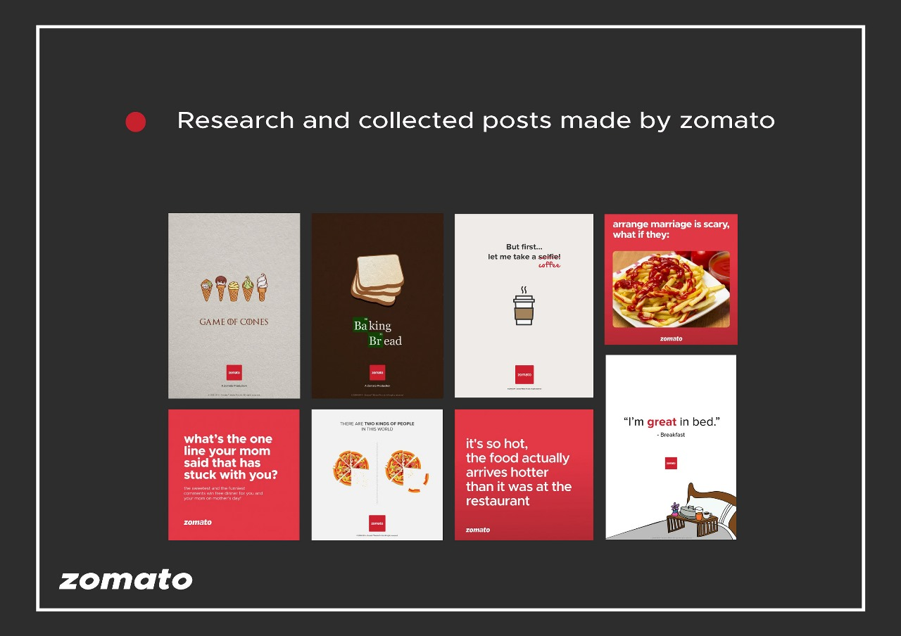
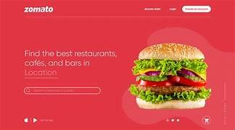

Slide 7
PROPOSED SYSTEM
the proposed improvements aim to overcome the limitations of the existing system by introducing automation, advanced analytics, and machine learning techniques for more accurate and insightful sentiment analysis of Zomato restaurant reviews.
the proposed improvements aim to overcome the limitations of the existing system by introducing automation, advanced analytics, and machine learning techniques for more accurate and insightful sentiment analysis of Zomato restaurant reviews.
the proposed improvements aim to overcome the limitations of the existing system by introducing automation, advanced analytics, and machine learning techniques for more accurate and insightful sentiment analysis of Zomato restaurant reviews.
Proposed System Improvements:
Automated Sentiment Analysis: Implementation of advanced NLP and machine learning models for automated sentiment analysis.
Clustering for Insights: Utilization of unsupervised learning for clustering restaurants, providing valuable insights into restaurant distribution and characteristics.
Scalability: Addressing the challenge of scale through automated and efficient analysis techniques.
Adaptability: Integration of models capable of adapting to evolving linguistic patterns and emerging sentiments.
Comprehensive Understanding: A more holistic approach towards understanding user behavior and preferences based on reviews.

Slide 8
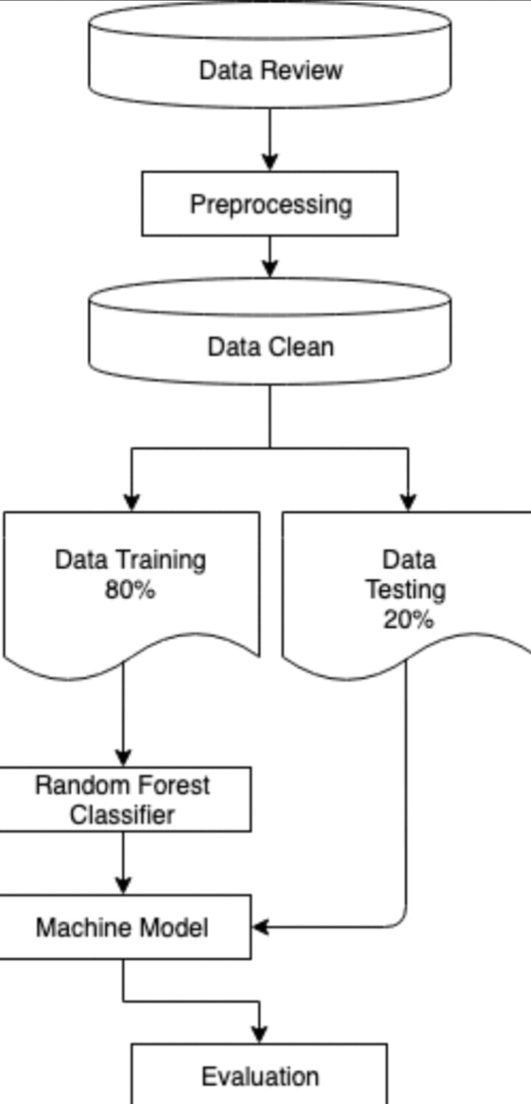
SYSTEM ARCHITECTURE

Slide 9
CONCLUSION
In the new digital era where large amounts of datasets are budding on the globe, to analyze the same and extract the result is getting popular. While building the paper, we studied a lot of research in a statistical manner to understand the need and greed of visualizing the dataset. For the same, a large number of researches have been taken into count. Using Python integrated with Tableau, we tried to represent about 1000 reviews from Zomato’s restaurant using visualization. Various techniques to visualize the dataset have been used for saving valuable user’s and restaurant owner’s time in the term of knowing the major quality of reviews of the restaurant is whether positive, neutral, or negative. Users can easily compare the highest-rated restaurant in his/her locality. Also, he/she can find localities with the most suitable cuisines restaurants.

Slide 10
THANK YOU

